Slide 1

Predicting customer buying behaviour
20/11/2022

Slide 2
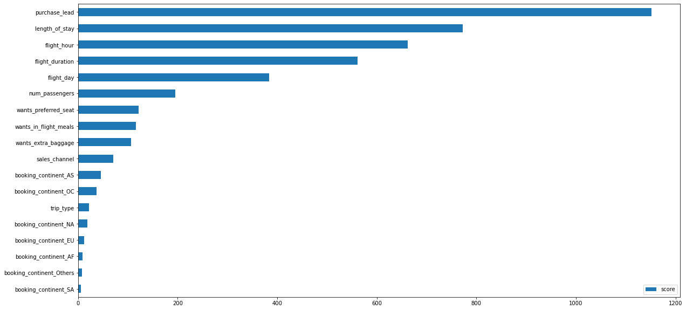
predictive model to understand factors that influence buying behavior
We have trained the data set with Random forest classifier model, we know that the influencing factors for customers to compete their bookings are:
Purchase_lead
Length_of_stay
flight_hour
flight_duration
Flight_day
These are the top 5 features which influence
Customer buying behavior.
ACCURACY: 83%
F1-SCORE: 0.22

